Slide 1
Anomaly prediction enhanced by NLP Techniques: Financial domain Loan default prediction
Capstone:
DSI Immersive-
Pramod Paul

Slide 2

Objective:
Enhancing Anomaly prediction for financial datasets BY NLP techniques

Slide 3
Datasets
NLP techniques on Lending Club loan default dataset available on Kaggle

Slide 4
Challenge: Present situation
In the financial domain, anomaly detection solutions were not able to use all the text data that was available for the customers like emails, chats with customer agents, survey information, financial transaction information, etc. Not able to channel these data to make better anomaly predictions.
Numerical and text data used separately. Training the NLP model to catch the anomaly was the most difficult part.

Slide 5
Proposed solution
Designing and implementing a prototype machine learning solution which can ingest both numeric and text data and make better predictions.
Training of the NLP model done by converting the dataset to text that NLP model understands.

Slide 6
Hacking to a possible solution: Part 1: Data set & Vectors Status: Done
Create a custom data set from numerical and text data
Custom dataset is tuned to the NLP technique so that training is quick and effective.
Vectors are generated for each customer in the dataset.

Slide 7
Hacking to a possible solution: Part 2: MODEL Status: Done
Choose
Choose a classifier model
Model
Model able to continuously ingest all the numerical & text info.
Model
Model to make better predictions based on new info.

Slide 8
Hacking to a possible solution: Part 3: WIP working with SME
Customer cube is the data point, which keeps on moving in the visualisation charts rather than the variables.
Customer cube is the full set of sentence embeddings which correspond to each feature.

Slide 9
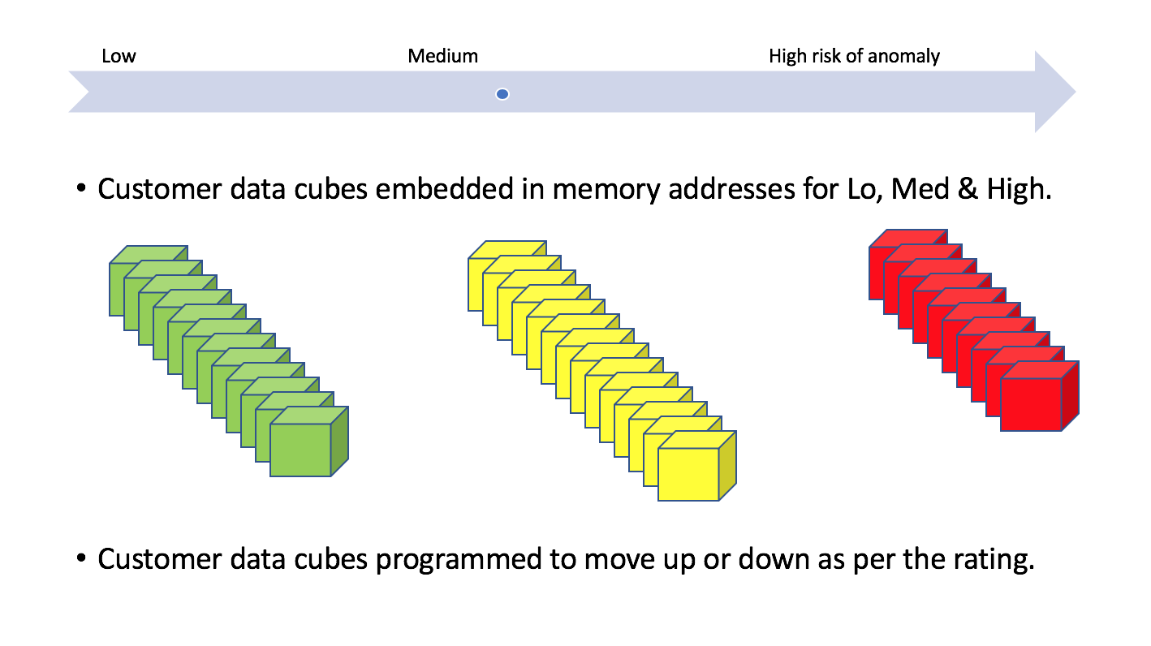

Slide 10
Hacking to a possible solution: Part 4: Benefits
Training
Model & Customer data cube can be trained with custom set of words to detect and predict any anomaly.
Interact
This model & customer data cube can interact with chatbots, sentiment analysis requests, recommendation engine and other info requests.
Blockchain-ready
Customer data cube can be part of a blockchain which holds all info about the customer.

Slide 11

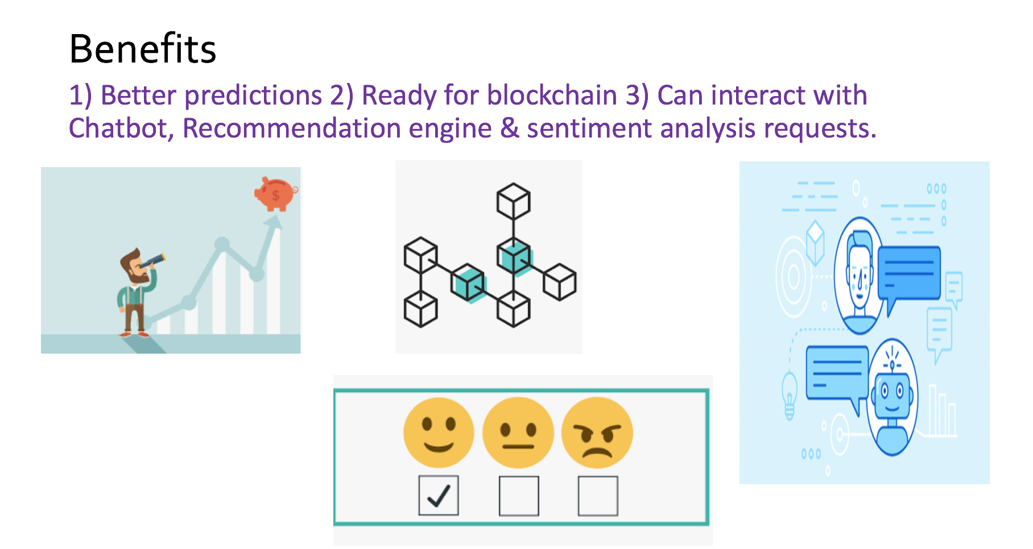

Slide 12
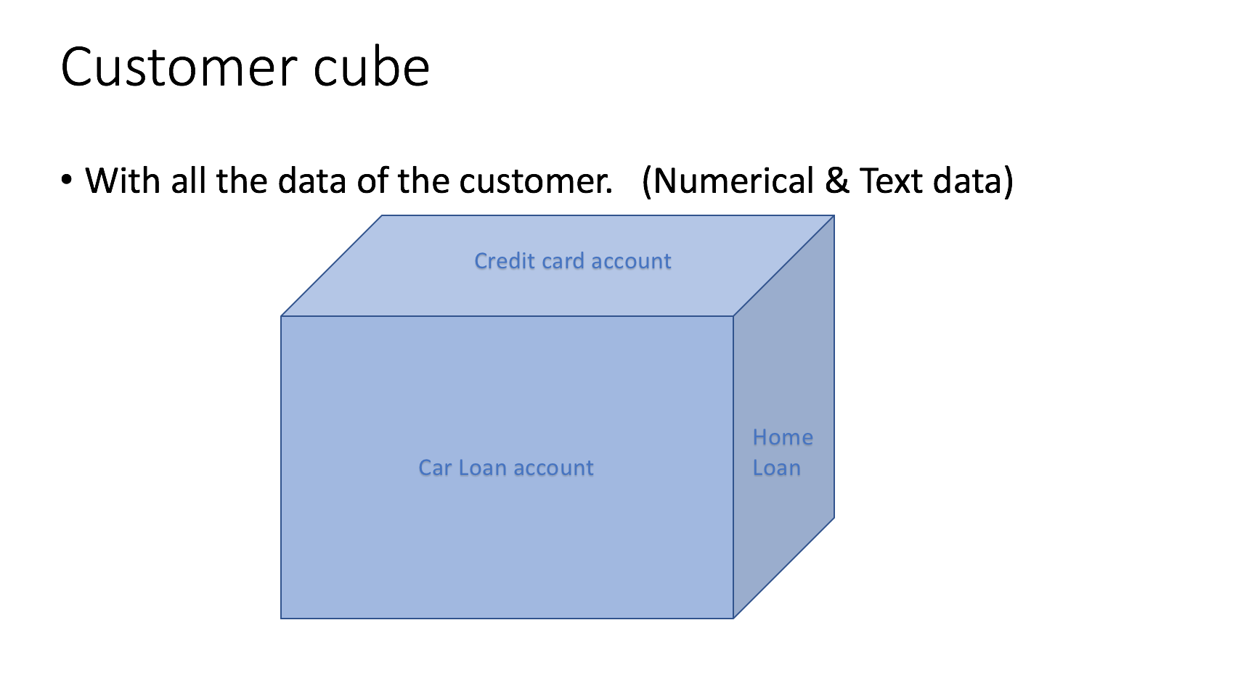

Slide 13
NLP techniques on Lending Club loan dataset: Doc2Vec
Distributed Bag of Words version of Paragraph Vector (PV-DBOW)

Slide 14
Loan default prediction using NLP techniques. (Trained on 100,000 rows. Accuracy improving when trained on more rows)
1) Models: Doc2Vec & Logistic regression
2) X = Doc2Vec vector representation of Num & text data
Y= Loan default predictions
3) Result: Accuracy score: 77%
F1 score : 0.81

Slide 15
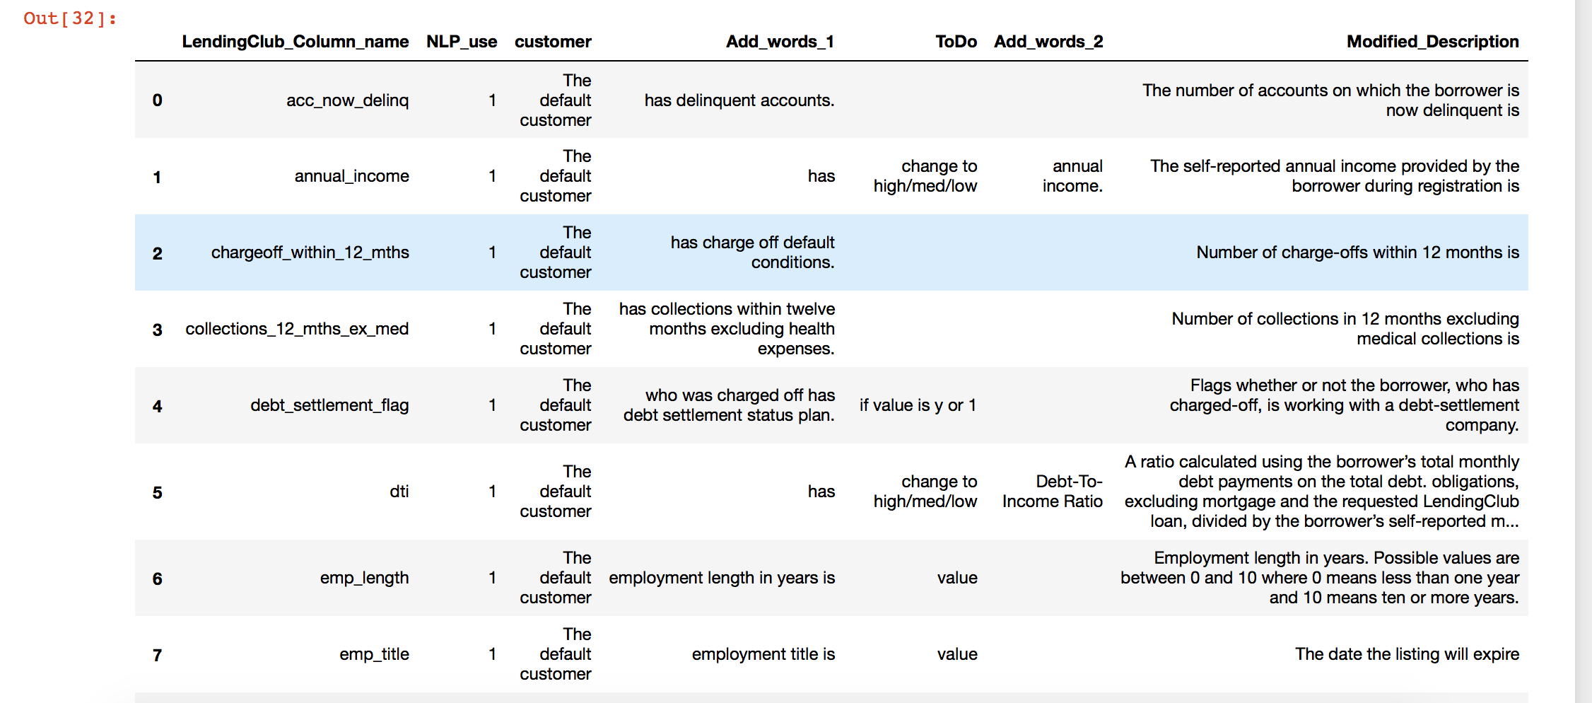
NLP techniques on Lending Club loan dataset: Created Custom data set

Slide 16
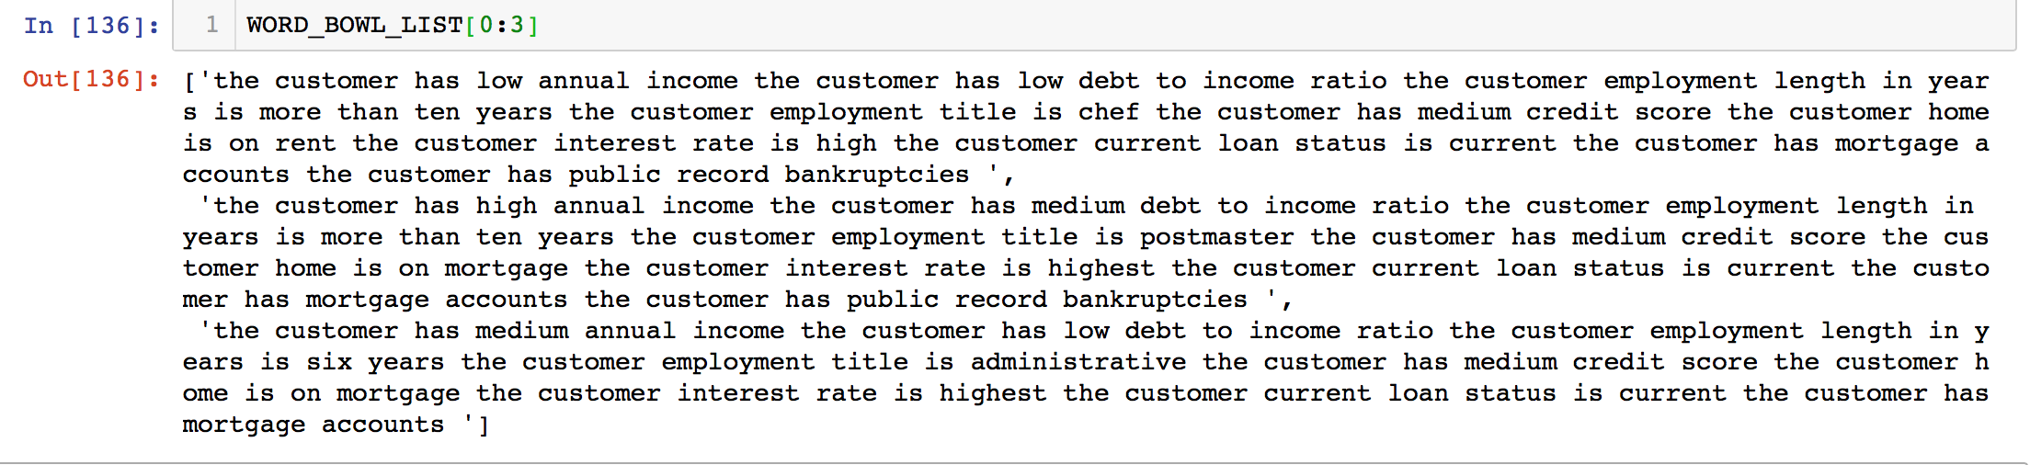
NLP techniques on Lending Club loan dataset: Created Custom data set

Slide 17
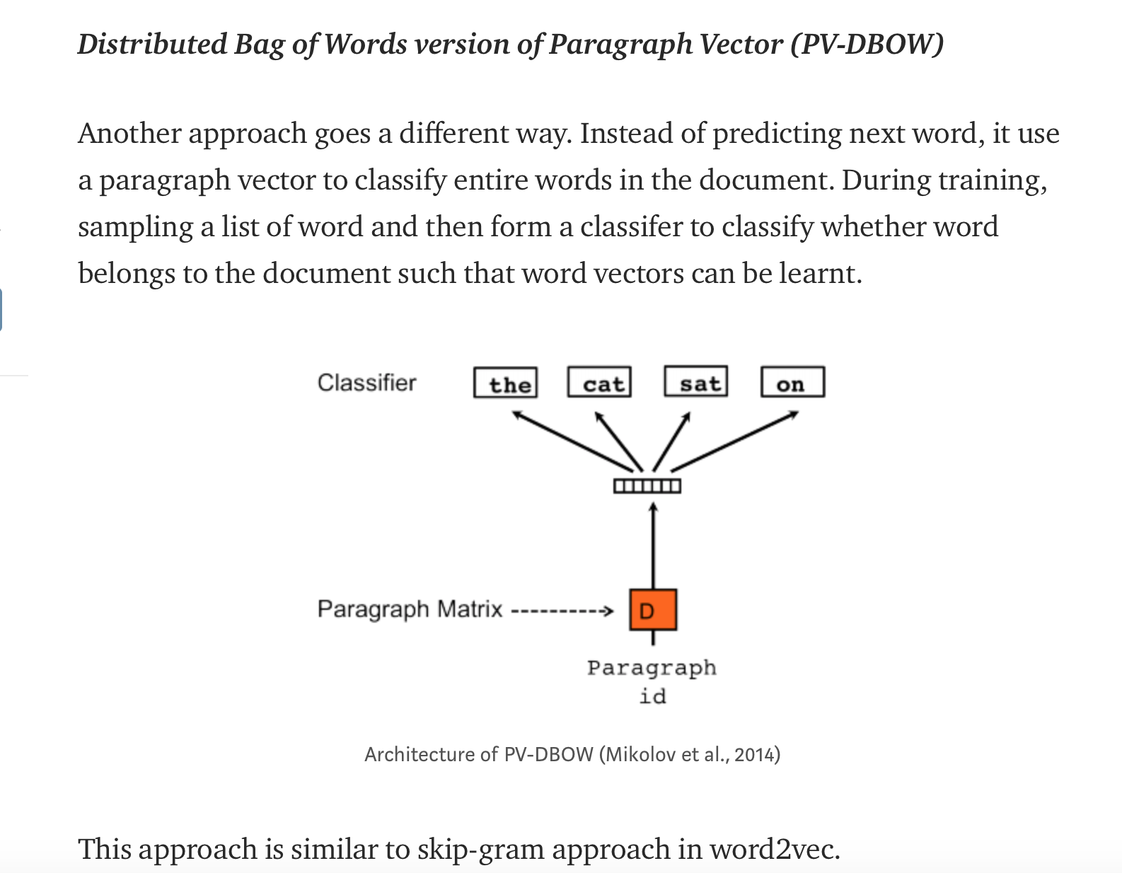
Doc2Vec option: Distributed Bag of Words version of Paragraph Vector (PV-DBOW)

Slide 18
Steps: (AION Doc2Vec embeddings used to create the paragraph vectors)
Training with X_train
to generate the vocabulary of words
Decode Testing & Training datasets
Pass the vectors to a classifier (Log reg) to generate results

Slide 19
Conclusion
Continue working for NLP custom embeddings on dataset with SME.
Implement web version using Flask

